Slide 1


Accenture Presentation

Slide 2


Agenda
Problem
Analytics Team
Process
Insights
Summary

Slide 3


Problem
The main problem is to identify the Top 5 Categories with the largest popularity.
We need to figure out that how can we calculate the most popular categories.

Slide 4



Sakshi Bhandwal
(Data Analyst)
The Analytics team
Andrew Fleming (Chief Technical Architect),
Marcus Rompton (Senior Principle)

Slide 5
Process
1
Data Collection
2
Data Cleaning
3
Data Manipulation
4
Data Analysis

Slide 6

Insights
16
1898
January
Unique Categories
Animal Category
Month with the most post

Slide 7
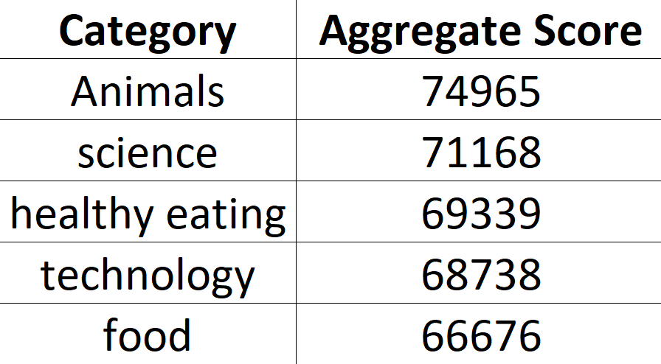
Removing the null values as they are taking the unnecessary space.
There were Three tables and these were reaction table, reaction type table and content table.
Created a final data set by merging three tables together using MS-Excel Vlookup function.
Reaction type is the common column in reaction and reaction type table which was useful in merging the reaction and reaction type table.

Slide 8
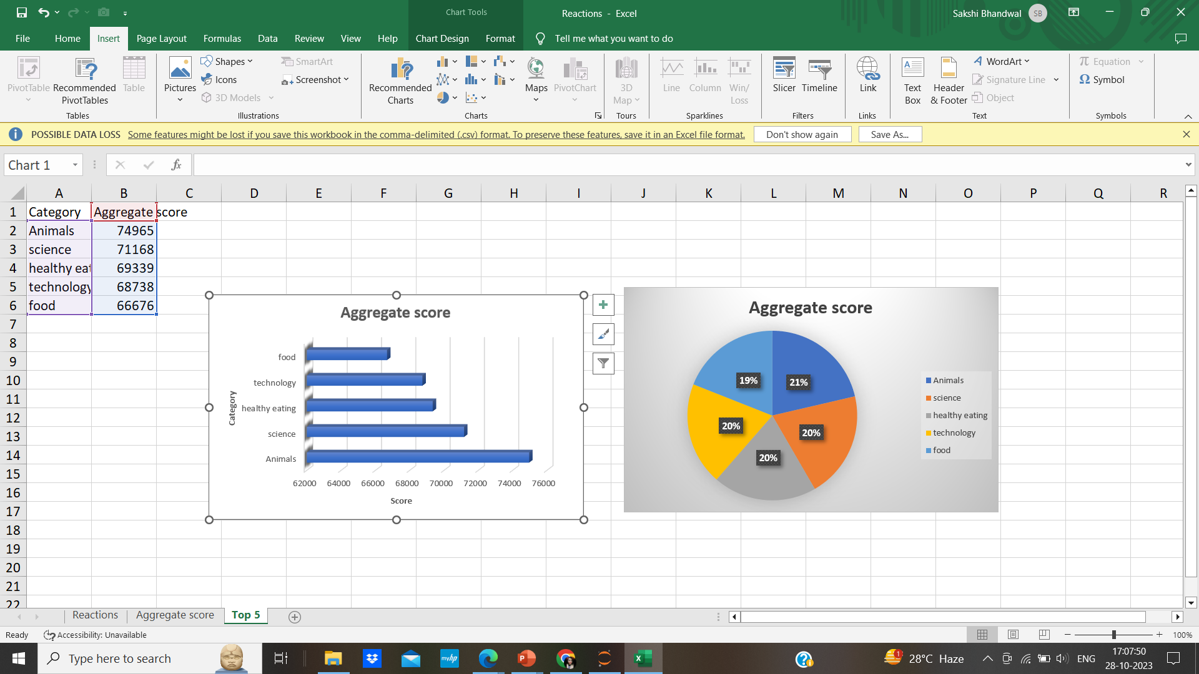
Similarly, Content ID is a common column in content table and reaction table which helped in merging the content and reaction table.
Popularity is quantified by the “Score” given to each reaction type.
Using the sumif function, we have calculated the total score of each category and arranged it into descending order using filter function.
Then we have selected the Top 5 Categories with the highest scores as shown below:

Slide 9

As we can see that Animals, Science are the categories with the highest popularity which is recognized by the maximum aggregate score.
Food and Healthy eating are the similar categories which falls in the top 5 most popular categories. You could use this insight to create a campaign and work with healthy eating brands to boost your engagement.
Summary

Slide 10
Thank you!

